Slide 1
T-ReX: Interactive Global Illumination of
Massive Models on Heterogeneous
Computing Resources
Presenter: Myungbae Son*
Tae-Joon Kim*, Xin Sun§, and Sung-Eui Yoon*
KAIST*, Microsoft Research Asia§
(To appear at) IEEE Transactions on Visualization and Computer Graphics (TVCG), 2014
Project Homepage
http://sglab.kaist.ac.kr/T-ReX

Slide 2





Global Illumination
$$w_{o}$$
$$x$$
$$L_{o}\left(x,w_{o}\right)=\int_{Ω}{f\left(x,w_{o},w_{i}\right)L_{i}\left(x,w_{i}\right)cosθdw_{i}}$$
Enormous computation is necessary
$$≈\frac{1}{N}\sum_{i=1}^{N}{\frac{f\left(x,w_{o},w_{i}\right)L_{i}\left(x,w_{i}\right)cosθ}{p(w_{i})}}$$

Slide 3
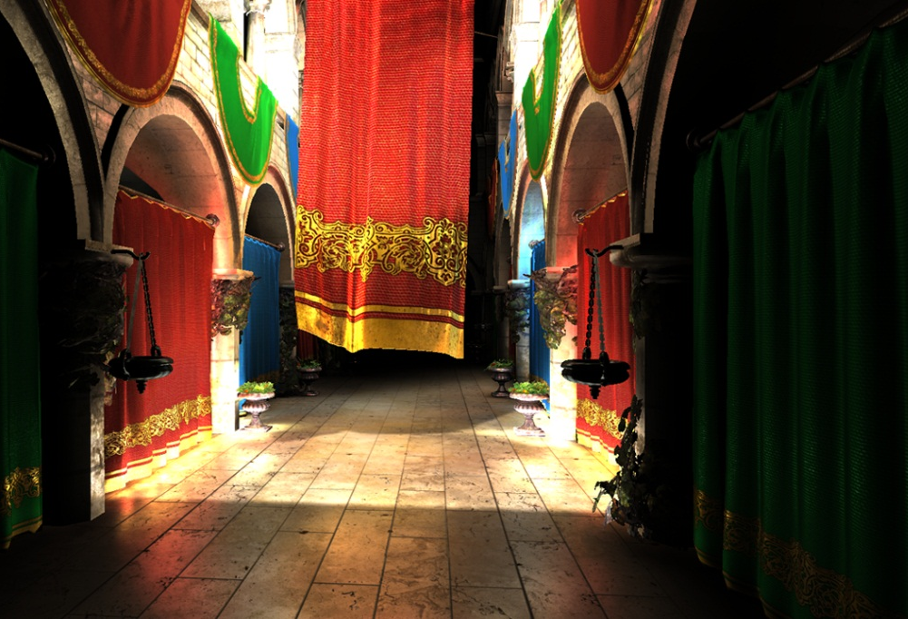
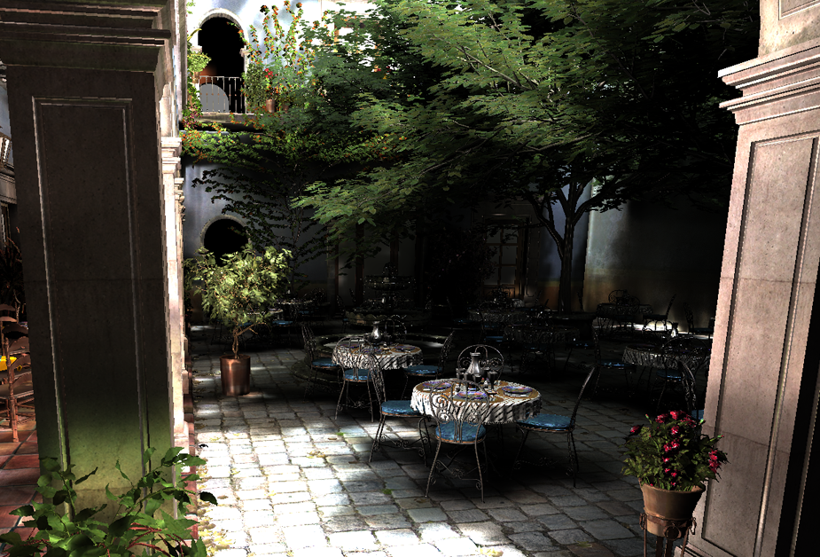
Interactive Global Illumination
Utilize GPU
Use sparse voxel octrees
Model complexity < 10 M tris.
Interactive Indirect Illumination Using Voxel Cone Tracing ^{[Crassin et al., PG11]}

Slide 4
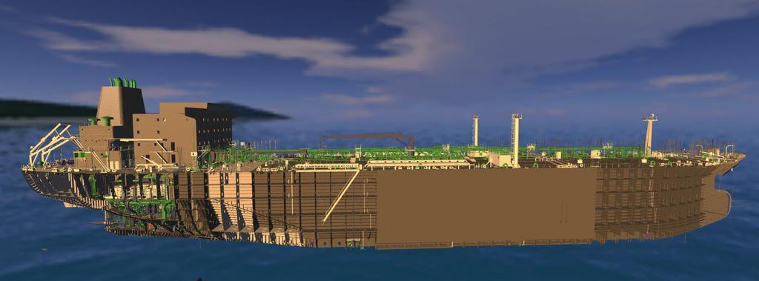
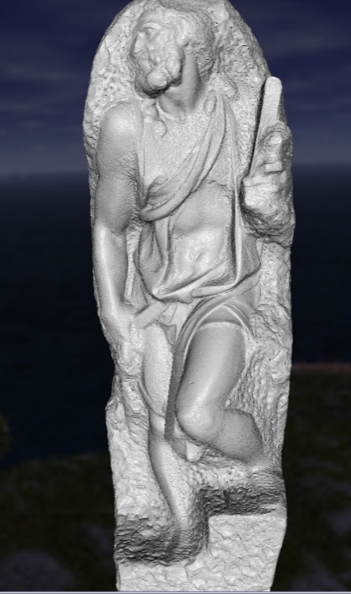
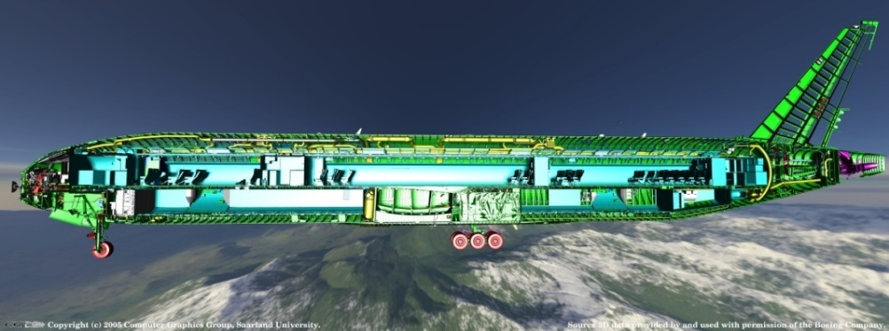
Massive Models
Due to advances of modeling, simulation, and data capture techniques
Long data access time and low I/O performance
CAD oil tanker, 82 M tri. (4 GB)
Scanned model,
372 M tri. (10 GB)
Boeing 777, 366 M tri. (20 GB)

Slide 5
Motivation
Global illumination of small models can be done interactively
  Thanks to advance of GPU architecture
Interactive global illumination with massive models is still challenging
  Maximize computation throughput
  Minimize I/O requirement

Slide 6
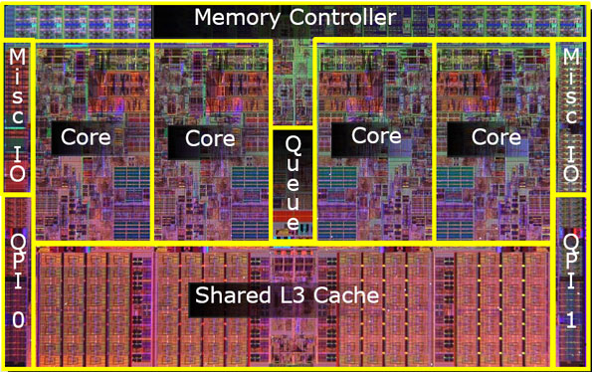
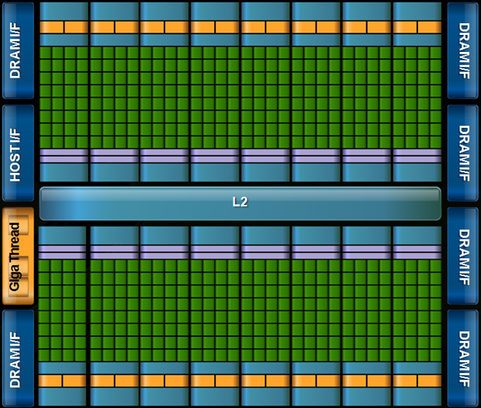
Heterogeneous Computing Resources
CPU
GPU
4 ~ 200 GB memory
2 ~ 8 GB memory

Slide 7
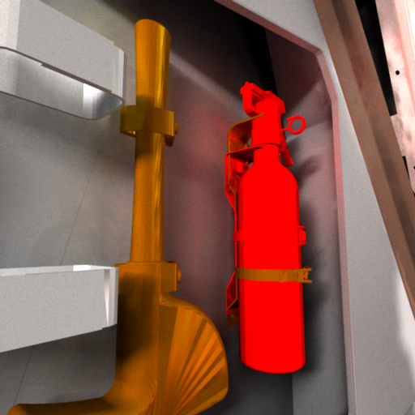
Observation
Global illumination effect is less sensitive to geometry details

Slide 8
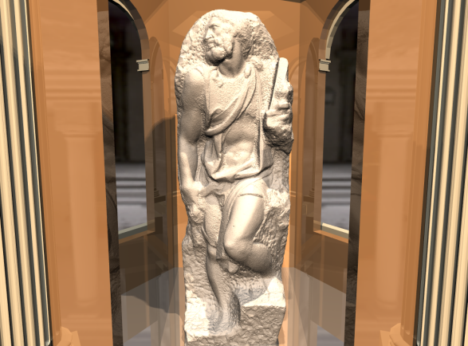
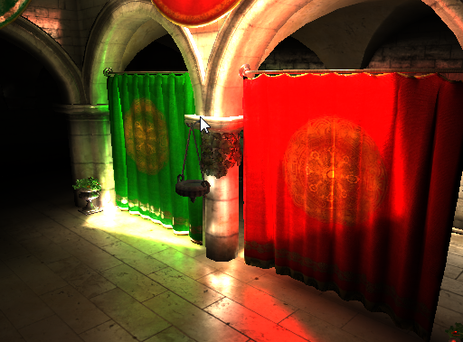
Our Approach
Hybrid approach
CPU
GPU
Transmit
inters. info.
Geometric representation
(full detailed, large)
Volumetric representation
of sparse voxel octree
(approximated, small)
Compute direct illumination
No mesh
data trans.
Compute indirect
illumination

Slide 9
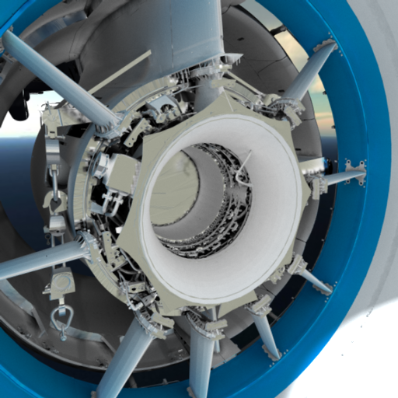
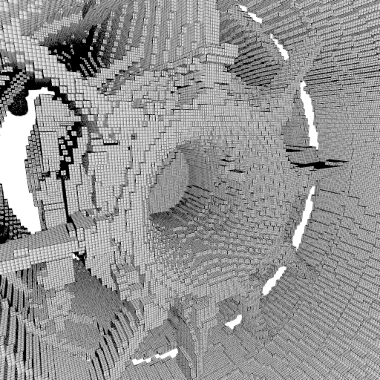
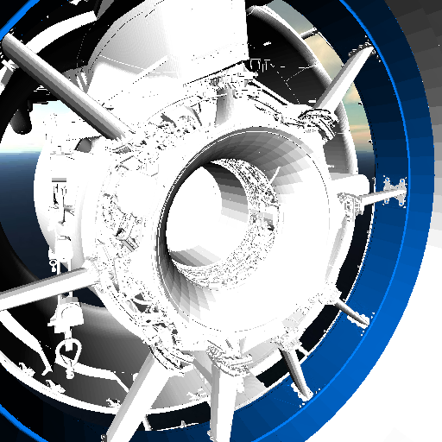
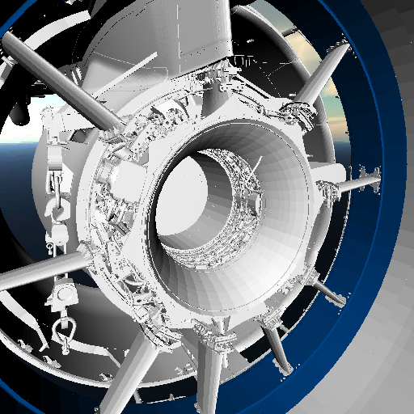
Approximated Illumination
Computed using
voxels
After shading
Raw mesh visualization
Approximated voxel representation

Slide 10

Results

Slide 11
Outline
Use photon mapping for rich visual effects
  e.g., color bleeding
Classify rays into fitting processors
  Each class of ray uses representation

Slide 12

Ray Classification
C-rays
  More sensitive to geometry details
  Generates high-frequency visual effects
  The primary rays and their secondary rays reﬂected on perfect specular materials

Slide 13
Ray Classification
G-rays
  Less sensitive to geometry details
  Generates low-frequency visual effects
  Any rays other than C-rays (e.g., gathering rays, shadow rays)

Slide 14
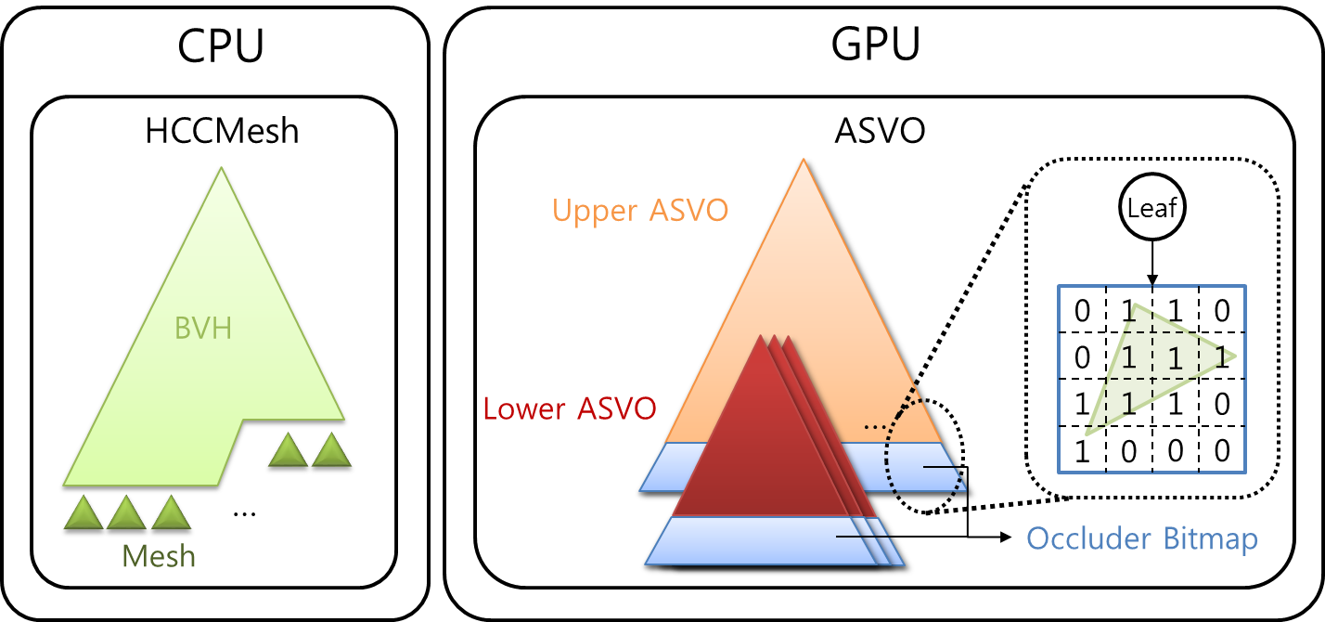
Data Representations
Augmented Sparse
Voxel Octree (ASVO)
GPU side volumetric representation for G-ray
Efficiently traversed in GPU
Approximated geometry & photon map
HCCMeshes ^{[Kim et al. Eurographics‘10]}
High quality geometry for C-ray
Random-accessible compression (7:1 ~ 20:1)
Supports high performance decompression

Slide 15
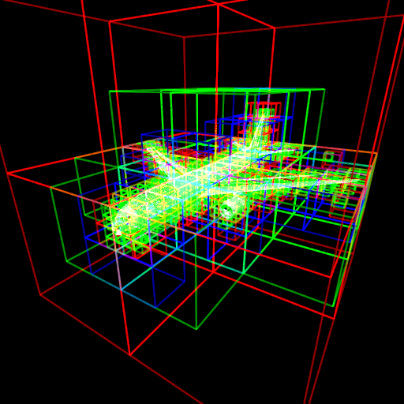
Augmented Sparse Voxel Octree
Provide increasing resolution
  Occluder bitmaps
Serves as LOD representation
  Representative materials,
  normals on each node
ASVO
Leaf
0
1
1
0
…
0
1
1
1
1
1
1
0
1
0
0
0
Occluder bitmaps

Slide 16
Augmented Sparse Voxel Octree
Two-level structure
  Upper ASVO (e.g., 300 MB) is always loaded on GPU memory
  Lower ASVO is asynchronously loaded on demand for progressive rendering
Upper ASVO
Lower ASVOs
…

Slide 17
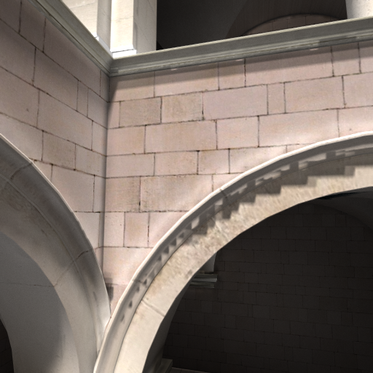
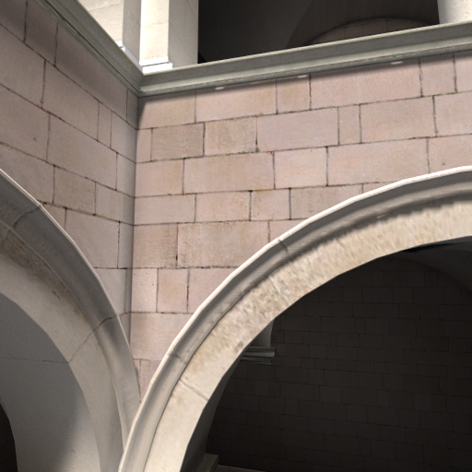
Effect of the Occluder Bitmap
Without considering
the occluder bitmap
Processing the occlusion with
the occluder bitmap

Slide 18
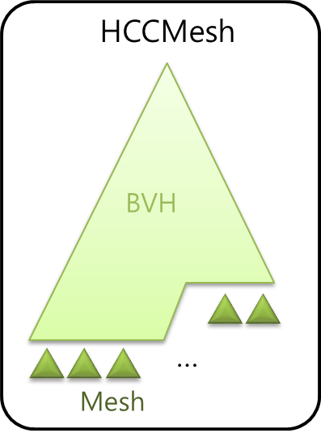
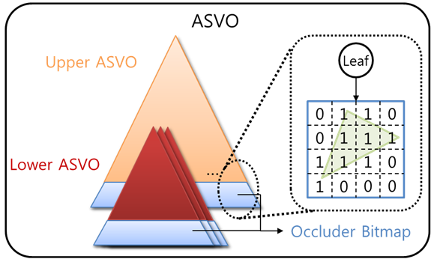
Rendering Process
CPU
GPU
Shading
Photon
Info.
Trace Photons
(Voxel)
Inter.
points
Photon
Info.
Trace C-ray
(Mesh)
Trace G-ray
(Voxel)

Slide 19
Dynamic Changes
Allows viewing, lighting, material changes
  Generates new photon for such dynamic changes and construct a new ASVO
  Blend old and new ones until the photon tracing is completed
    Similar to the concept of geomorphing
Shading
Trace Photons
Photon
Info.
Old ASVO
New ASVO

Slide 20
Results
Interactive responsiveness
  About 30 ms response time for dynamic changes on cameras, materials, and lights
High performance
  3 M ~ 20 M rays/s
High complexity
  Up to 470 M triangles

Slide 21
Results
Test environment (PC)
  Intel Core i7 CPU (hexa-core) w/ 8 GB RAM
  NVIDIA GTX 680 card with 2 GB DRAM
    15% of GPU memory was allocated for upper ASVO
Boeing 777 model benchmark
  366M Triangles
  15.6 GB mesh + 21.8 GB BVH for raw model
  6.55 GB for HCCMesh
  11 area lights (generated 5 M photons each)

Slide 22
Comparison
3.9 times improvement over CPU-only implementation
  Same algorithm, but running on CPU only
  Main memory holds both representations (HCCMeshes, ASVOs)
135 times improvement over simple photon mapping on CPU
  Using HCCMeshes only

Slide 23
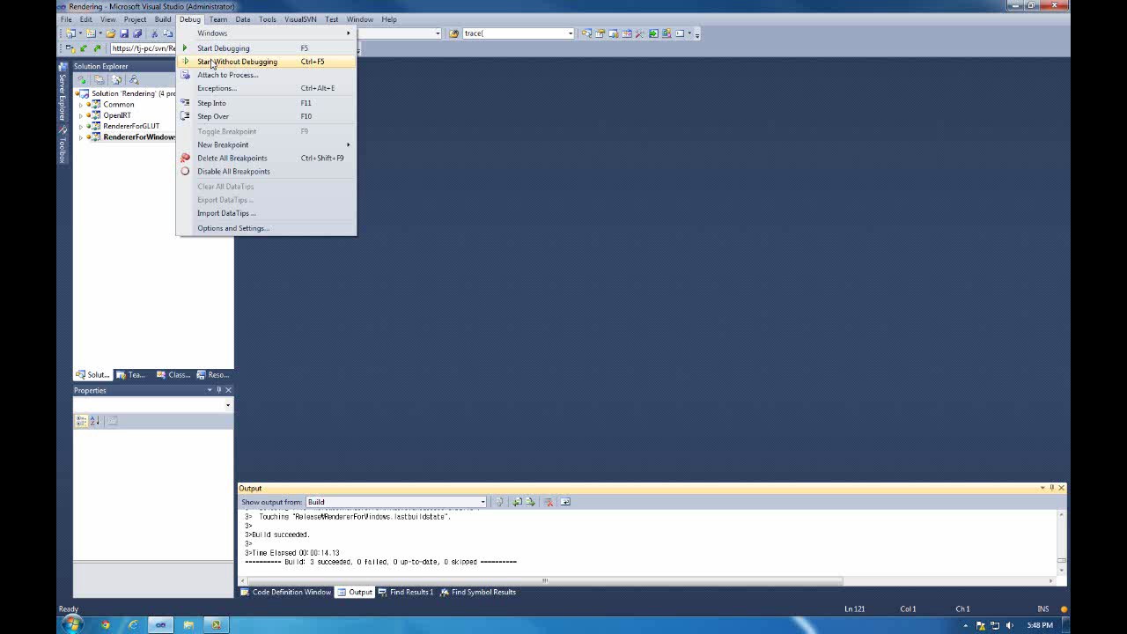
Demonstration

Slide 24
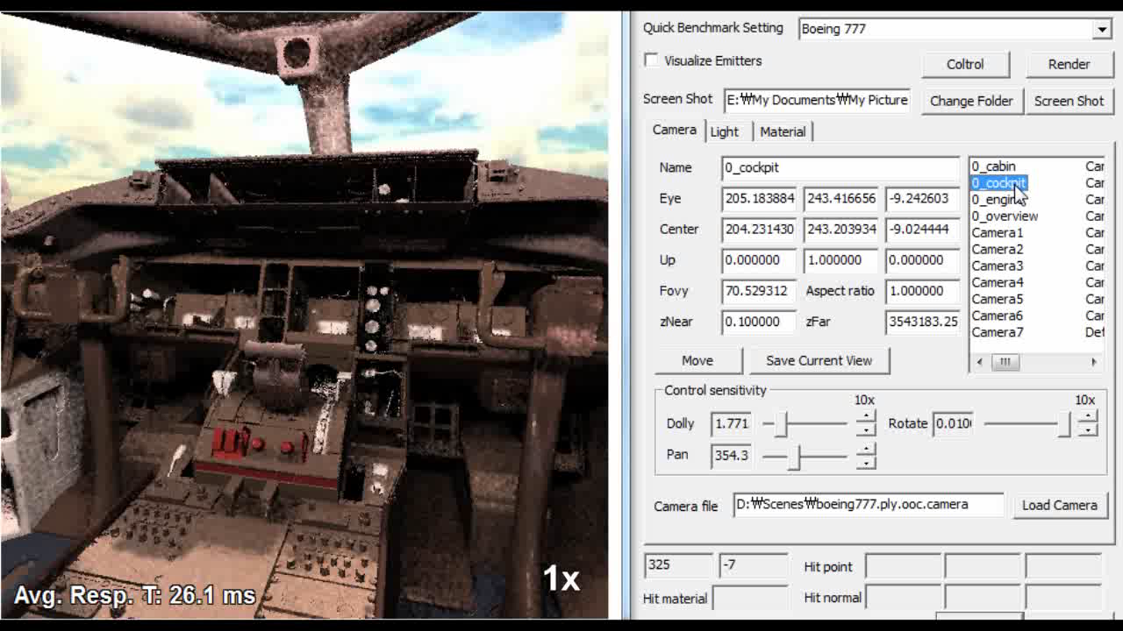
Progressive Rendering
Progressively refine the frame

Slide 25
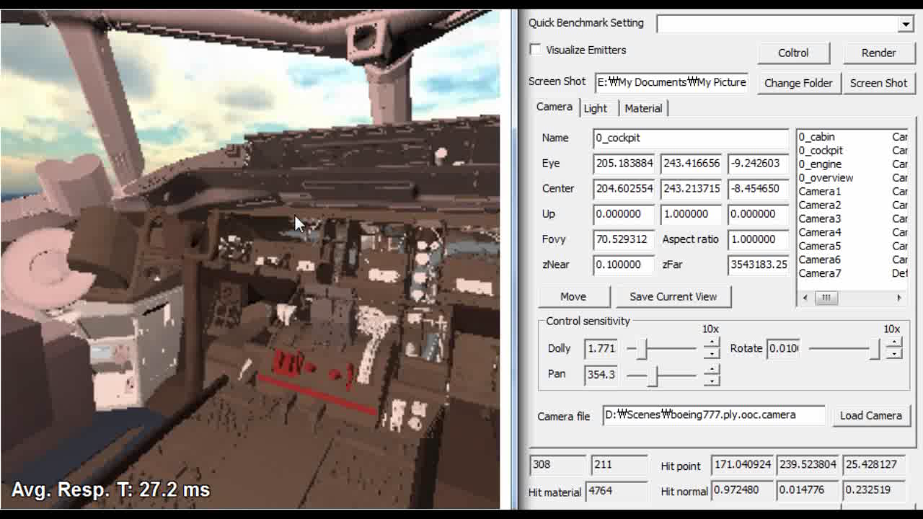
Materials Changes

Slide 26
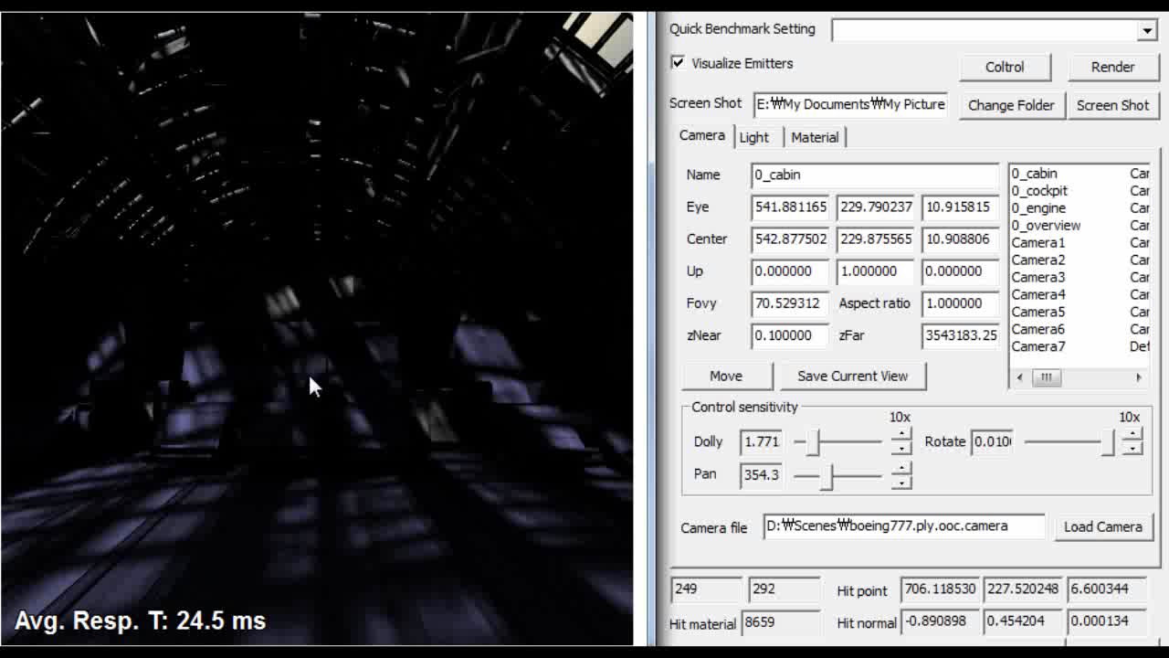
Lights Changes

Slide 27
Conclusion
Present an integrated progressive rendering framework for global illumination of massive models
  Use a decoupled representation: HCCMeshes in CPU and ASVOs in GPU for handling large-scale models
Reduce expensive transmission costs and achieve high utilizations for CPU and GPU

Slide 28
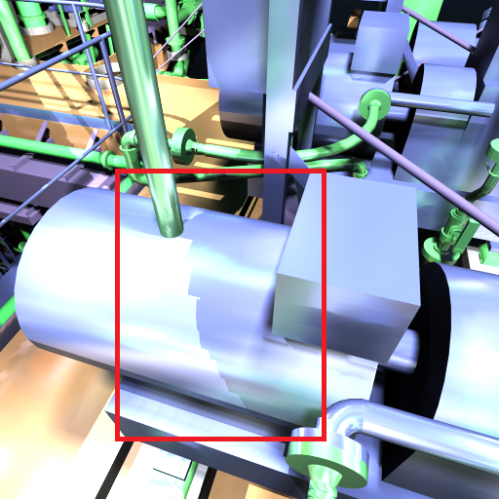
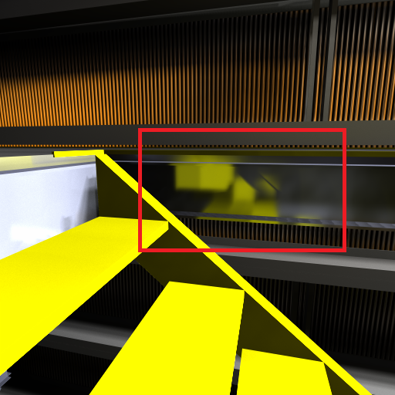
Limitations
Volumetric representation
  Biased and inconsistent
  Spans more space than its geometric model
Point light sources
Highly glossy materials

Slide 29
Future Work
Can be extended to adopt progressive photon mapping
Optimization between two different metrics
  High rendering throughput
  Low user responsiveness

Slide 30
Acknowledgement
Members of KAIST SGLab for their supports
Model donors
  The Boeing 777 model for David Kasik at the Boeing Company
  The Double Eagle model for NNS
  The power plant environment for an anonymous donor
  Sponza for Marko Dabrovic
  St. Matthew models for Stanford Univ.
  Isosurface model for LLNL
This project was supported in part by following:
  MCST/KOCCA/CT/R\&D 2011,DAPA/ADD (UD110006MD), MEST/NRF/WCU (R31-30007), BK, KMCC, MSRA, ExoBrain, MEST/NRF (2012-0009228).

Slide 31
Q & A
Thank you!
The source code is available at the project homepage:
http://sglab.kaist.ac.kr/T-ReX

