Slide 1
Line Segment Sampling with Blue-Noise Properties
Xin Sun¹ Kun Zhou² Jie Guo³ Guofu Xie^{4,5} Jingui Pan³ Wencheng Wang⁴ Baining Guo¹
¹Microsoft Research Asia ²State Key Lab of CAD & CG, Zhejiang University
³State Key Lab for Novel Software Technology, Nanjing University
⁴State Key Laboratory of Computer Science, ISCAS ⁵GUCAS & UCAS
Notes:
Good morning!
I will present our work on line segment sampling with blue-noise properties.

Slide 2
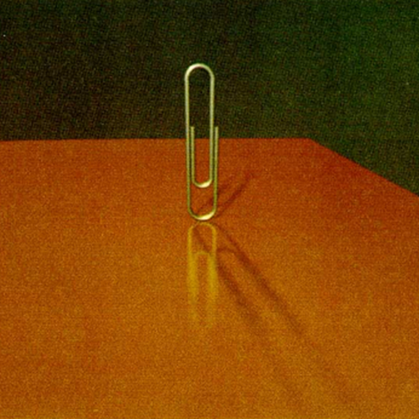
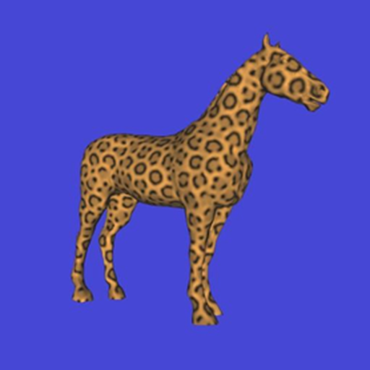
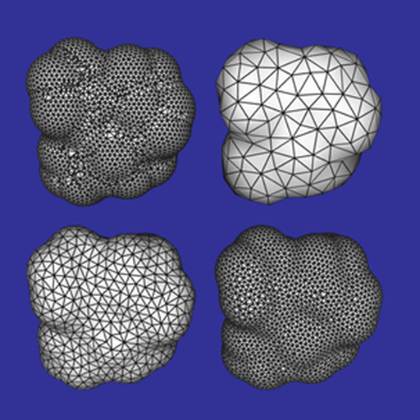
Point Sampling Applications
Ray Tracing
[Cook et al. 1984]
Texture Mapping
[Turk 1991]
Remeshing
[Turk 1992]
Notes:
Points have been widely used as samples in many applications of graphics.
Here are just a few examples including rendering, texture mapping and geometry processing.

Slide 3
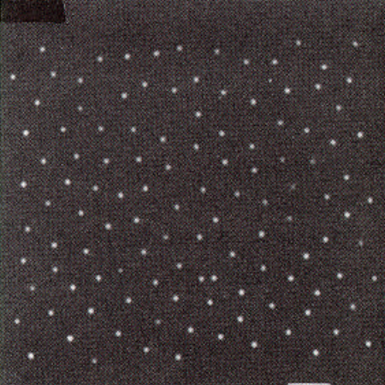
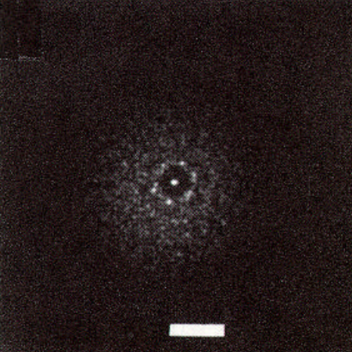
Point Sampling with Blue-noise Properties
Low discrepancy and randomness
Monkey eye photoreceptor distribution.
Optical transform of monkey eye.
Fig. 3 in [Cook 1986]
Notes:
Decades ago, people gained an understanding that samples with blue-noise properties perform excellently in graphics applications because of their low discrepancy and randomness.
Here is an example of blue-noise cited by Cook.
In the frequency domain, the low frequency content should be near zero while the high frequency content should be like white noise.

Slide 4
Point Sampling with Blue-noise Properties
Relaxation and dart throwing
  [Lloyd 1983; Cook 1986]
Efficient blue-noise sampling
  Sampling on the fly [Dunbar and Humphreys 2006; Bridson 2007]
  Precomputation [Cohen et al. 2003; Ostromoukhov et al. 2004, 2007; Lagae and Dutré 2005; Kopf et al. 2006]
  Spatial hierarchies [Mitchell 1987; McCool and Fiume 1992; White et al. 2007]
  Parallelism [Wei 2008; Bowers et al. 2010; Ebeida et al. 2011, 2012]
  Adaptive sampling [Hachisuka et al. 2008]
  Statistical mechanics [Fattal 2011]
Quantitative analysis of Poisson disk sampling
  [Wei and Wang 2011; Zhou et al. 2012; Öztireli and Gross 2012]
Notes:
Because of its importance, point sampling with blue-noise properties has been intensively studied during the last thirty years, including both theoretical analysis and practically efficient sample generation.

Slide 5
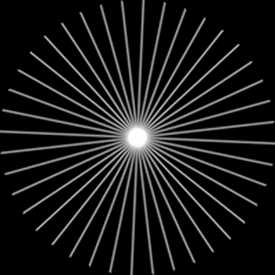
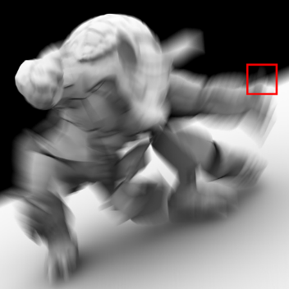
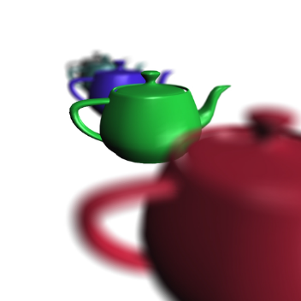
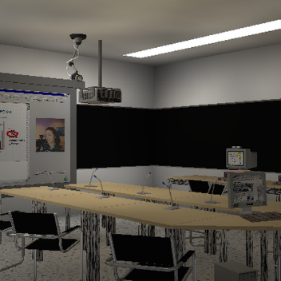
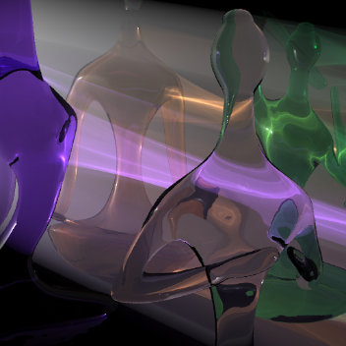
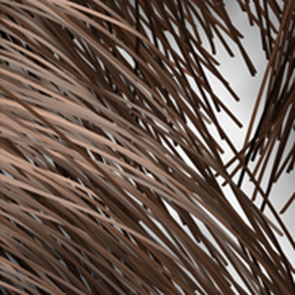
Line Segment Sampling Applications
Anti-aliasing
[Jones and Perry 2000]
Motion blur
[Akenine-Möller et al. 2007;
Gribel et al. 2010; Gribel et al. 2011]
Depth of field
[Tzeng et al. 2012]
Global illumination
[Havran et al. 2005]
Volumetric scattering
[Jarosz et al. 2008,2011a,2l11b;
Sun et al. 2010; Novák et al. 2012a,2012b]
Hair rendering
[Barringer et al. 2012]
Notes:
Recently, line segment sampling has demonstrated substantially higher efficiency than point sampling in terms of both storage and computation in many rendering applications,

Slide 6
Line Segment Sampling w/ Blue-noise Properties
?
Notes:
A question consequently raised is how to generate line segment samples with good properties.
Although many algorithms have been proposed over the past thirty years for generating blue-noise point samples, to our knowledge there does not exist much work on analysis and sampling schemes for line segment samples.

Slide 7
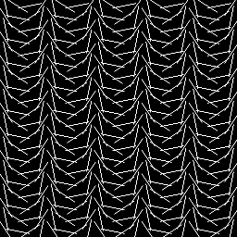
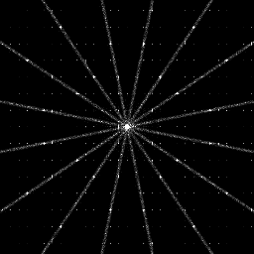
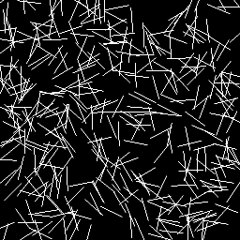
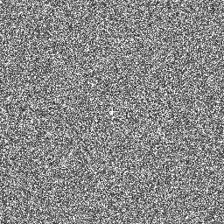
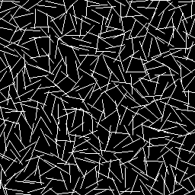
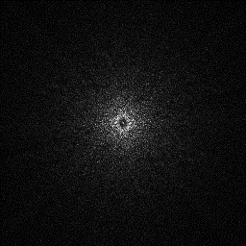
Current Approaches for Line Segment Sampling
Uniform sampling
Random sampling
Blue-noise positions
Random directions
Notes:
Simple uniform sampling, random sampling or specific sampling schemes extended from previous point sampling methods have been tried in previous work.
As shown here, the left image of each pair shows the samples and the right images are the corresponding frequency content.
The first two cannot provide blue-noise properties. The last one works better, but the reasons are not understood and whether it is the best scheme is not know either.
It is thus necessary and important to perform an analysis on the properties of line segment samples and design appropriate sampling schemes based on the analysis.

Slide 8
Our Contribution
A theoretical frequency analysis of line segment sampling
A sampling scheme to best preserve blue-noise properties
Extensions to high dimensional spaces and general non-point samples
Notes:
Our work has three main contributions.
[click]
We conduct a frequency analysis of line segment samples.
[click]
Based on the frequency analysis, we propose a line segment sampling scheme that best preserves blue-noise properties.
[click]
While these first two items are done for line segment samples in 2D space, we also extend them to high dimensional spaces and general non-point samples.
[click]
This third item will not be presented here due to limited time. Please refer to our paper to learn about it.

Slide 9
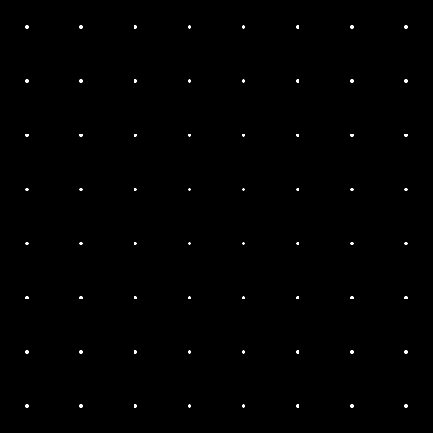

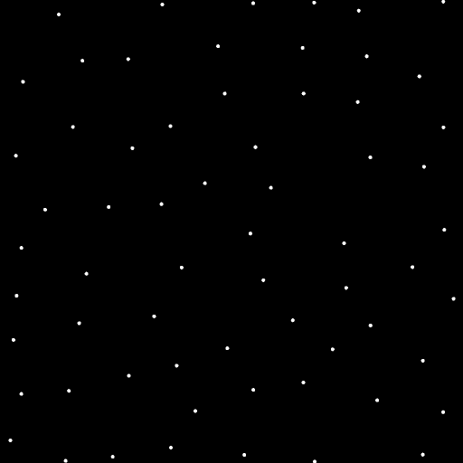
Quick Conclusion: Point Sampling
☹
☹
☺
Notes:
Before diving into the details, I would like to show you some simple and intuitive conclusions of our work.
This is the conclusion of point sampling from previous work.
Blue noise sampling out-performance uniform sampling and random sampling

Slide 10

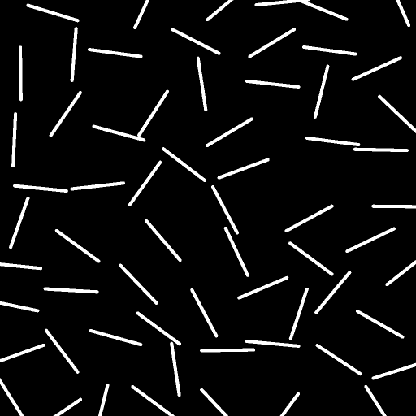
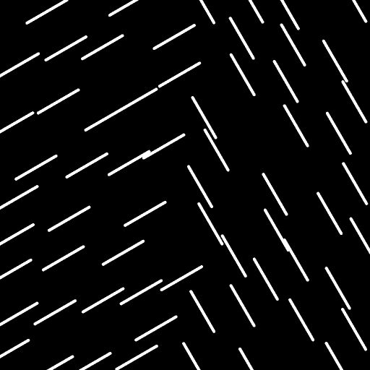
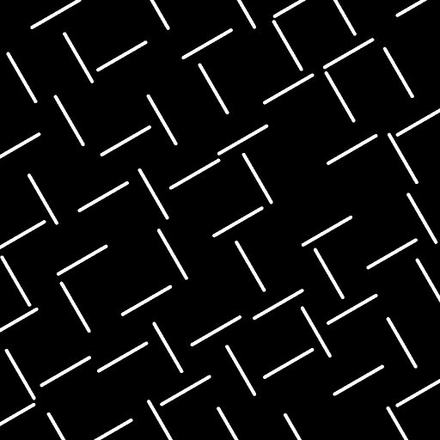
Quick Conclusion: Line Segment Sampling
☹
☹
☹
☺
Notes:
For line segment samples with the same length, multiple direction sampling, directional alignment and multi-class poisson disk sampling of center positions are important to preserve blue-noise properties.

Slide 11
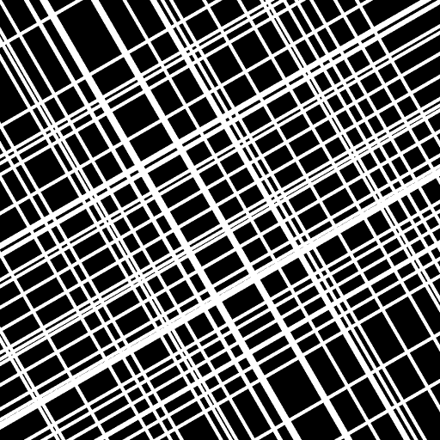
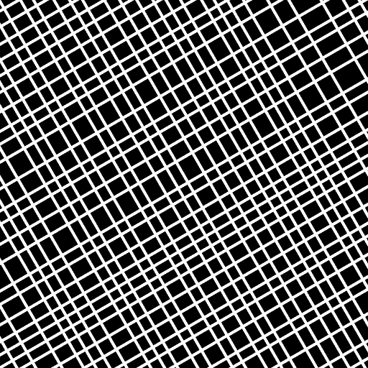
Quick Conclusion: Line Sampling
☹
☺
Notes:
For line samples with infinite length, the Poisson disk distribution of displacement among parallel samples is critical.
We will show the reasons and analysis in the following.

Slide 12
Outline
Relationships of freq. content (point, line and line segment samples)
Line segment sampling schemes
Applications
Notes:
The rest of this presentation consists of three parts.
[click] First, we will explain the relationships among the frequency content of different samples, including point samples, line samples and line segment samples.
[click] Second, we will introduce the corresponding sampling schemes.
[click] Finally, we will validate our analysis and sampling schemes in some rendering applications.

Slide 13



Frequency Content: a Point Sample
$$xc$$
A point sample
Power spectrum
Notes:
A point sample is an impulse function located at an infinitely small point.
[click] Its power spectrum is uniformly constant throughout the whole frequency domain.

Slide 14









Frequency Content: a Line Sample
$$−R$$
A line sample
Power spectrum
Notes:
A line with infinite length is defined as this.
[click]We assume that its coefficients are normalized.
[click]A line sample is a line impulse along a straight line.
[click]d denotes a direction perpendicular or parallel to the line.
[click]The frequency content of this sample is like this,
[click]where \omega is the frequency parameter along d.
[click]Because of the line impulse in this term, the frequency content of a line sample in the spatial domain also lies on a line in the frequency domain, perpendicular to the original line and passing through the origin.

Slide 15









Frequency Content: a Line Segment Sample
$$⋅$$
$$xc$$
$$l$$
$$⋅l2$$
A line segment
sample
Power spectrum
Notes:
A line segment sample can be defined by cropping a line sample.
[click] H is the step function.
[click] The frequency content of a line segment sample is equivalent to a weighted point sample.
[click] The weight can be analytically evaluated.
[click] The shape of the power spectrum is determined by the sinc function in the weight.
[click] In general, the frequency content of a line segment sample is a band, whose width is determined by the length of the sample.

Slide 16

Frequency Content: a Line Segment Sample
$$⋅$$
$$⋅l2$$
A longer line
segment sample
Power spectrum
Notes:
For a longer sample, the band containing frequency content is narrower.

Slide 17

Frequency Content: a Line Segment Sample
$$⋅$$
$$⋅l2$$
A shorter line
segment sample
Power spectrum
Notes:
For a shorter segment, the band becomes wider.

Slide 18
Relationships of Frequency Content
$$l$$
Notes:
Point sampling, line sampling and line segment sampling are intrinsically the same.
Their frequency content changes smoothly according to their length.
Short line segment samples act like point samples while long line segment samples are similar to line samples.
The longer length leads to narrower bandwidth in frequency content, which introduces stronger anisotropy.

Slide 19
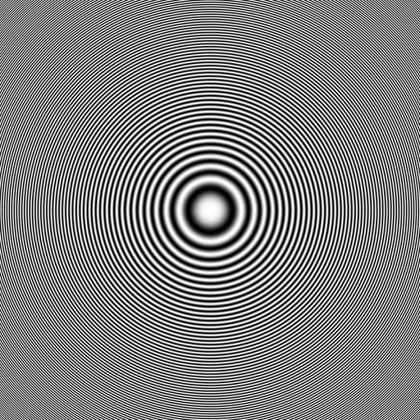
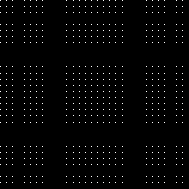
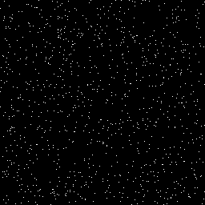
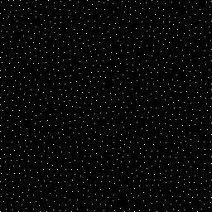
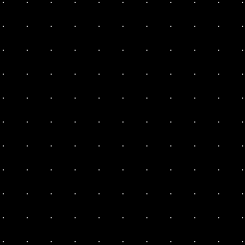
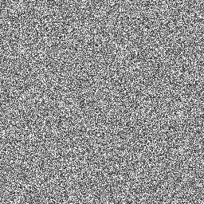
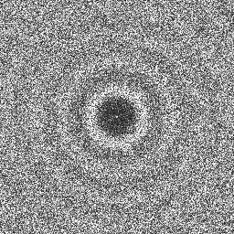
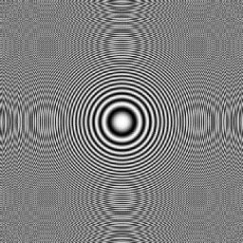
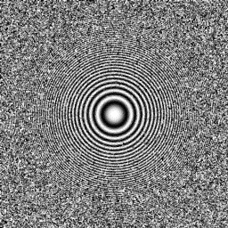
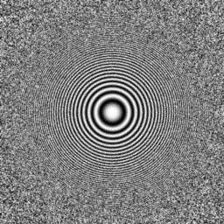
Blue-noise Sampling: Point Samples
Uniform
Random
Blue-noise
Notes:
Blue-noise properties are important in point sampling.
[click] In the frequency domain, uniform sampling generates periodic impulses, random sampling produces white noise properties, and blue-noise sampling is near-zero in low frequencies and white noise in high frequencies.
[click] To reconstruct an image like this,
[click] blue-noise sampling provides the best quality, compared with the aliasing from uniform sampling and the noise from random sampling.

Slide 20
Blue-noise Sampling: Point Samples
Low discrepancy
  Reduce noise
Randomness
  Reduce aliasing
Independent on the shapes of samples
Notes:
Samples with blue-noise properties perform excellently in applications because of their low discrepancy and randomness.
[click] That conclusion is not dependent on the shapes of the samples. As it is true for point samples, it should also be important for line segment sampling.

Slide 21

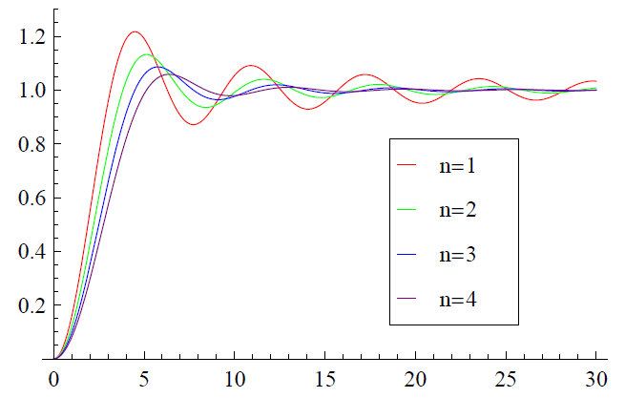






Blue-noise Sampling: Point Samples
Quantitative analysis
  Differential domain analysis [Wei and Wang 2011]
$r$ is Poisson disk distance
when $r=1$,
$0F1$ is a confluent
hypergeometric function
Fig. 9 in [Wei and Wang 2011]
Notes:
The blue-noise properties of Poisson disk sampling were quantitatively analyzed by Wei and Wang in 2011.
[click] Based on the assumption of a Poisson disk distribution,
[click] The power spectrum is quantitatively measured based on the distribution of the displacements among the samples.
[click] According to that conclusion, the power spectrum of line segment sampling can also be analytically evaluated as follows.

Slide 22



Blue-noise Sampling: Line Samples
Only samples with the same direction overlap in frequency
With the same direction, a line sample in 2D space is equivalent to a point sample in 1D space
The position of the point sample in 1D space is $−R$
$$−R$$
Notes:
We have got the frequency content of a line sample.
[click] The term of the line impulse indicates that samples with different directions are not related in the frequency domain.
[click] Compared with the frequency content of a point sample,
[click] we can see that \omega\perp corresponds to the frequency parameter,
[click] while the position parameter becomes – R
So the frequency content of a 2D line sample is equivalent to that of a 1D point sample along the straight line determined by the delta term.
[click] And the power spectrum can also be obtained accordingly, when –R is picked with Poisson disk sampling in 1D space.

Slide 23

Blue-noise Sampling: Line Samples
Samples are divided into several groups
Within a group, the directions of samples should be exactly the same without any jittering or perturbation
  Simply uniformly sample directions among groups (not our research focus)
Within a group, the $−R$ of samples are Poisson disk sampled in 1D
Notes:
We note that a key factor for line sampling with blue-noise properties is perfect directional alignment.
[click] We first divide the samples into several groups.
[click] Within a group of line samples, their direction should be exactly the same without any jittering or perturbation.
As the direction sampling is not our focus, we just simply uniformly sample directions among different groups
[click] And the – R of samples are Poisson disk sampled in 1D

Slide 24
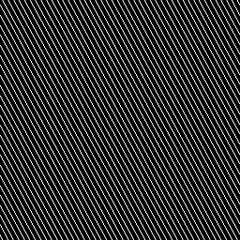
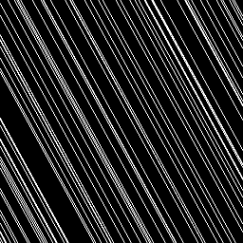
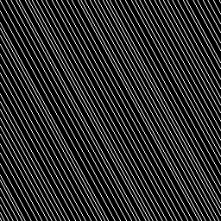
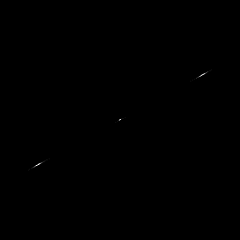
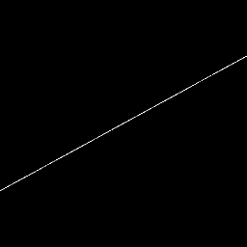
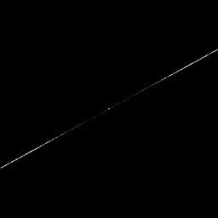
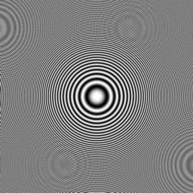
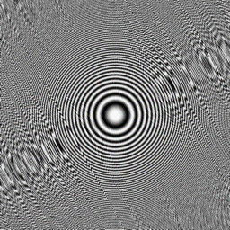
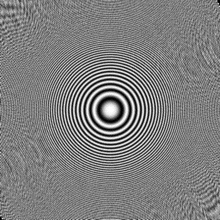
Line Sampling with Single Direction
Uniform
Random
Blue-noise
Notes:
This is an example where we sample in only one direction.
[click] The frequency content of the three sampling scheme are as expected.
[click] And the reconstruction quality is also consistent to the sampling properties. Blue noise properties help to reduce both aliasing and noise.
As only one direction is sampled, we find strong angular anisotropy even with blue-noise sampling.

Slide 25
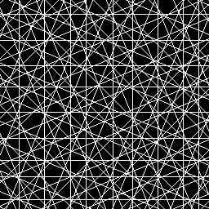
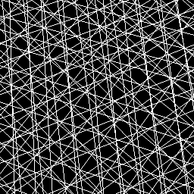
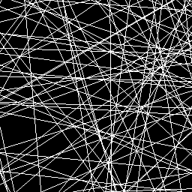
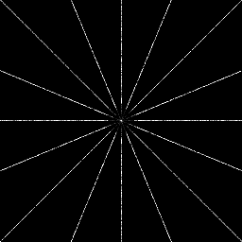
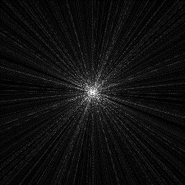
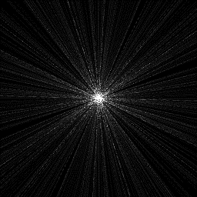



Line Sampling with Multiple Directions
Eight directions
Jittered directions
Random directions
Notes:
So we tried eight groups, each with a different sampling direction.
[click] In the sampling schemes of the rightmost two images, the directions of samples are not strictly aligned, and the blue-noise properties totally disappear.
[click] We still see the anisotropy in the sampling scheme on the left. That can be alleviated by sampling more directions.
Jittering shown in the middle image is randomly and slightly change the direction of each sample.
It is not a good choice because of the substantial noise it introduces.

Slide 26






Blue-noise Sampling: Line Segment Samples
A line segment sample is equiv. to a weighted point sample
The weights are determined only by the directions and lengths $l$ of the line segment samples
Assumption: the lengths $l$ of all samples are the same
$$xc$$
$$l$$
$$⋅l2$$
Notes:
According to the frequency content,
[click] A line segment sample is equivalent to a weighted point sample.
[click] The weights are determined only by the directions and lengths of the samples.
[click] The power spectrum of a line segment sample is also equivalent to the power spectrum of a point sample and the corresponding weight.
The lengths l determine the width of the band while the direction \omega\parallel determines the direction of the band.
[click] We assume the length of all samples are the same. So that the bands can be aligned for samples with the same directions.

Slide 27

Blue-noise Sampling: Line Segment Samples
Samples are divided into several groups
Within a group, the directions of samples are the same
  Simply uniformly sample directions among groups (not our research focus)
The $xc$ of samples are multi-class Poisson disk sampled in 2D [Wei 2010], and the samples in each group belong to an individual class
Direction jittering can help reduce angular aliasing with a small compromise in noise
Notes:
The sampling scheme of line segment samples is very similar to the line sampling scheme.
[click] There are only two differences.
The first difference is that the positions of line segment samples are multi-class Poisson disk sampled in 2D. Each group is an individual class.
The second difference is that jittering maintains blue-noise properties while reducing the angular aliasing.

Slide 28









Line Segment Sampling with Single Direction
Uniform
Random
Blue-noise
Notes:
Only one direction is sampled here.
[click] The differences of frequency content can be seen clearly.
[click] And blue noise sampling produces the best reconstruction accordingly.

Slide 29









Line Segment Sampling w/ Multiple Directions
w/o M-C
w/ M-C
w/ M-C and jittering
Notes:
This is a comparison with multiple sampling directions.
[click] The multi-class scheme gives much better blue-noise properties.
[click] The jittering scheme significantly reduces the angular anisotropy with a small compromise of blue-noise properties.
The reconstruction on the right looks better than the two schemes on the left.
This should be the best sampling scheme in many rendering applications.

Slide 30








Applications: Image Reconstruction
Line sampling
Reference
Line segment
sampling
Uniform
Random
Blue-noise
Blue-noise
w. jittering
Notes:
This is a simple application of image reconstruction.
Due to the limited resolution of the slides, the differences may not be very visible here.
We encourage you to take a look of our paper, where you can zoom into the figures to get much clearer comparisons among the different sampling schemes.
For both line sampling and line segment sampling, the blue-noise sampling schemes produce the best results, as seen from the noise of random sampling and aliasing of uniform sampling.

Slide 31
Applications: Image Reconstruction
Uniform
Random
Blue-noise
Blue-noise
w. jittering
Reference
Notes:
This is a close-up comparison for line segment sampling.
Uniform sampling generate un-existing pattern, while the random sampling totally convert the fiber structure to random noise.

Slide 32

Applications: Motion Blur
Stochastic rasterization
  [Gribel et al. 2011]
The image is divided into square tiles of resolution 32
Within each tile, we sample four directions each with 32 line segment samples
Notes:
Recently, line segment sampling has been employed in stochastic rasterization [Gribel et al. 2011] to achieve better quality as well as low computational cost.
The basic idea is to divide the image into a set of tiles, each of which covers a small rectangular region.
Within each tile, line segments that cross the whole tile are sampled instead of the point samples employed in the traditional rendering pipeline.
We implement this rendering framework for motion blur except that we only modify the generation of line segments in the tiles.

Slide 33








Applications: Motion Blur
Uniform
Blue-noise
Blue-noise w. jittering
Reference
Notes:
As shown here, aliasing is caused by both the high-frequency textures and non-linear motions.
Our blue-noise sampling scheme converts the aliasing into noise.
We also allow a tradeoff between aliasing and noise by jittering according to the requirements of the application.

Slide 34

Applications: Depth of Field
Extended from[Gribel et al. 2011]
The image is divided into square tiles of resolution 32
Within each tile, we sample eight directions each with 32 line segment samples
Notes:
The line segment sampling for motion blur rendering [Gribel et al. 2011] can be directly extended to render depth of field.

Slide 35








Applications: Depth of Field
Uniform
Blue-noise
Blue-noise w. jittering
Reference
Notes:
Aliasing artifacts are generated in both in-focus and out-of-focus areas if we uniformly sample the line segments.
Our blue-noise sampling reduces the stratified aliasing, but the effects are not smooth enough for the out-of-focus blur as expected.
The jittering scheme helps smooth out the remaining aliasing and generates results much more consistent to the ground truth.

Slide 36


Applications: Temporal Light Field Recon.
Low-discrepancy sampling in $5D$
  [Lehtinen et al. 2011]
A point sample in $5D$ light field space is a shape sample in $2D$ image space
Blue-noise properties in $2D$
  A much higher sampling rate in $5D$
  Discard most samples based on $xc$
Notes:
The temporal light field reconstruction method proposed by Lehtinen et al. [2011] is efficient in rendering distribution effects such as depth of field and motion blur.
They generate low discrepancy samples in 5D light field space.
Based on our analysis, the quality of samples is determined by their position distribution in the image space.
So we sample in the 5D space with a much higher sampling rate.
Then we discard most of them according to their center position, such that the remaining samples have blue-noise properties in the image space.

Slide 37




Applications: Temporal Light Field Recon.
1 spp in $5D$
64 spp in $5D$, drops to 1 spp in $2D$
Notes:
The comparison here validatesour analysis. Our samples generated by the preprocessing produce a much better reconstruction result.

Slide 38


Applications: Temporal Light Field Recon. (refocus)
1 spp in $5D$
64 spp in $5D$, drops to 1 spp in $2D$
Notes:
Such reconstruction quality improvement are also found after refocusing.

Slide 39
Conclusion
Frequency analysis
  In frequency domain, a line segment is a weighted point sample.
  The weight introduces anisotropy changing smoothly with the length.
Sampling scheme
  Multiple directions
  Samples with the same directions have Poisson disk distributed center positions in 1D (line samples) or 2D (line segment samples) space.
  Jittering helps to reduce anisotropy of line segment sampling
Extensions to high dimensional spaces and general non-point samples
Notes:
To conclude,
[click] A line segment is equivalent a weighted point sample.
The weight introduces the anisotropy changing smoothly with the length, which bridges point samples, line samples and line segment samples.
[click] Direction alignment is the key in a sampling scheme. With the same direction and length, blue-noise samples can be easily generated as Poisson disk distributed center positions in 1D or 2D spaces. Jittering can help reduce anisotropy of line segment sampling.
[click] We show in our paper that this can be extended to high dimensional spaces and general non-point samples.

Slide 40
Future Work
Sampling with different shapes or dramatically different sizes
Different sampling rates between parallel and vertical directions
Notes:
There are a couple interesting follow-ups for future work.
[click] The first is how to generate hybrid samples with different shapes or dramatically different sizes.
For example, we can use line segment samples for areas with less angular aliasing and employ point samples elsewhere.
[click] The second is how to adaptively sample along the directions of samples according to their lengths.
For example, in motion blur rendering with sheared filtering, the sampling rates along the motion direction should be much lower than in the perpendicular direction.

Slide 41
Acknowledgements
Reviewers for their valuable comments
Stephen Lin for paper proofreading
Li-Yi Wei and Rui Wang for discussions
Jiawen Chen for sharing the code of temporal light field recon.
Funding
  NSFC (No. 61272305) and 973 program of China (No. 2009CB320801)
  Knowledge Innovation Program of the Chinese Academy of Sciences
Notes:
We would like to thank following people for their help.

Slide 42
Thank You !
Notes:
That’s all. Thank you!

