Slide 1
Diffusion Curve Textures for Resolution Independent Texture Mapping
Xin Sun* Guofu Xie†‡ Yue Dong* Stephen Lin*
Weiwei Xu* Wencheng Wang† Xin Tong* Baining Guo*
*Microsoft Research Asia
†State Key Laboratory of Computer Science, ISCAS
‡ GUCAS
Notes:
In this talk, we introduce a vector texture representation called diffusion curve textures for mapping diffusion curve images (DCI) onto arbitrary surfaces.

Slide 2
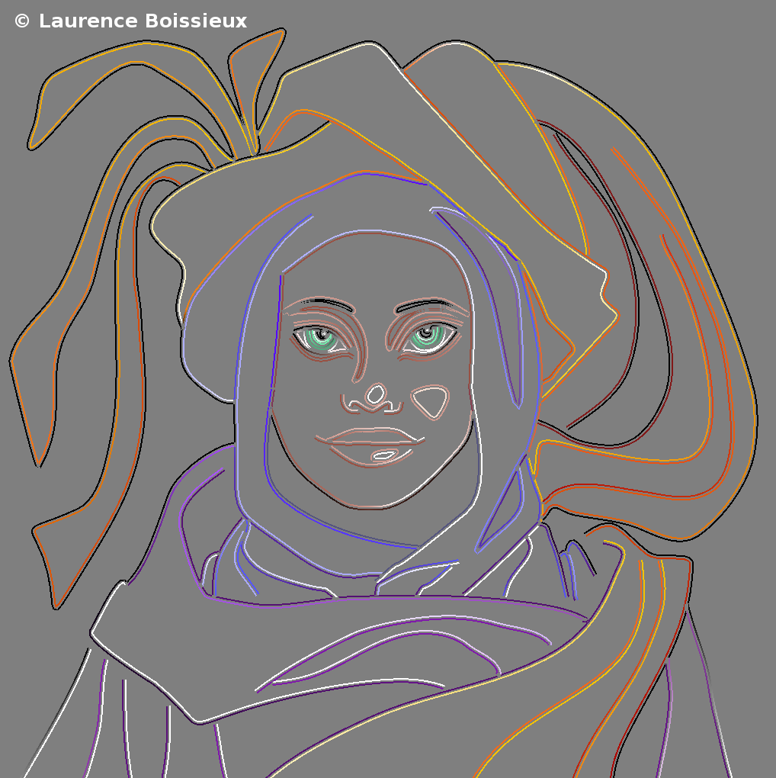
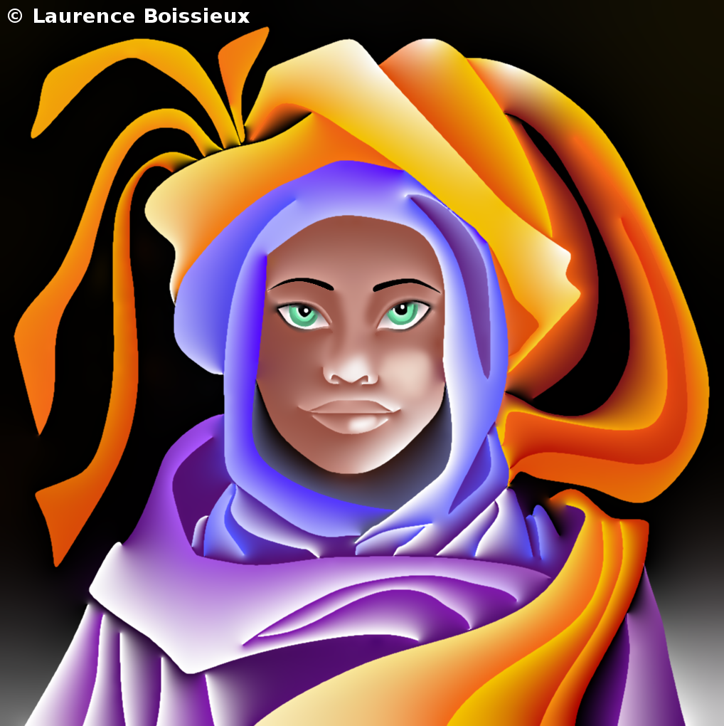

Diffusion Curve Image (DCI)
Definition
  Color defined on control curves
  Shading in-between by solving a Poisson equation
Advantage
  Sparse control curves (compact)
  Rich and smooth shading variations & Sharp boundary
Solving
Control curves
Shading in-between
Notes:
A diffusion curve image is a powerful vector graphics representation. By defining colors along a sparse set of control curves,
[click]
the diffusion curve image generates a smooth shaded image between the curves by solving a Poisson diffusion equation.
[click]
As with other vector graphics models, diffusion curves have a concise representation
[click]
and provide resolution independent sharp boundaries as well as rich and smooth shading variations.

Slide 3
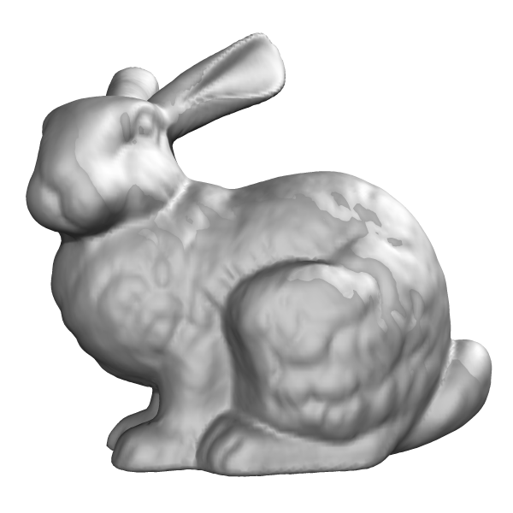
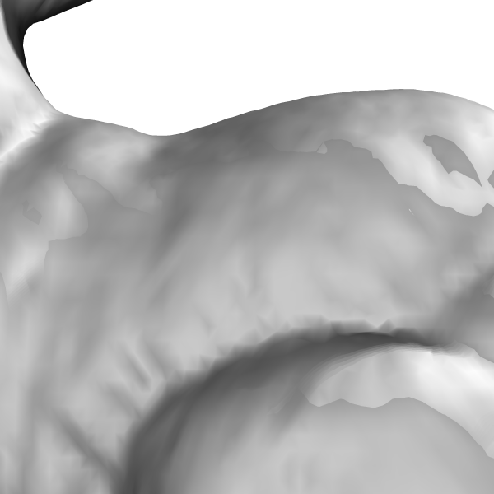
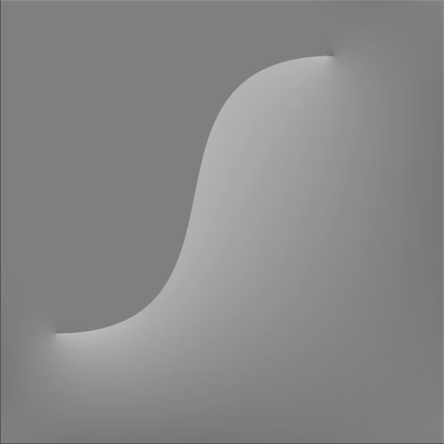


Challenges for DCI Textures
Full image is reconstructed to fetch one texture value
$$u(x)$$
$$u(x)$$
Mesh
DCI texture
Texture value
Notes:
However, there are two challenges when we want to map a diffusion curve image onto an arbitrary mesh for rendering.
As shown here, given the geometry mesh and the diffusion curves
[click]
In order to obtain the DCI value mapped to a particular surface point
[click]
the full image must be synthesized by solving a Poisson equation over the grid.
Thus, it cannot support random access of individual texture values.
[click]
Moreover, to preserve sharp texture boundaries in close-up views,

Slide 4


Challenges for DCI Textures
Full image is reconstructed to fetch one texture value
More memory (higher resolution) for close-up views
$$u(x)$$
$$u(x)$$
Mesh
DCI texture
Texture value
Notes:
[click]
The full image needs to be reconstructed on a higher resolution grid, which leads to large computational and storage costs.

Slide 5
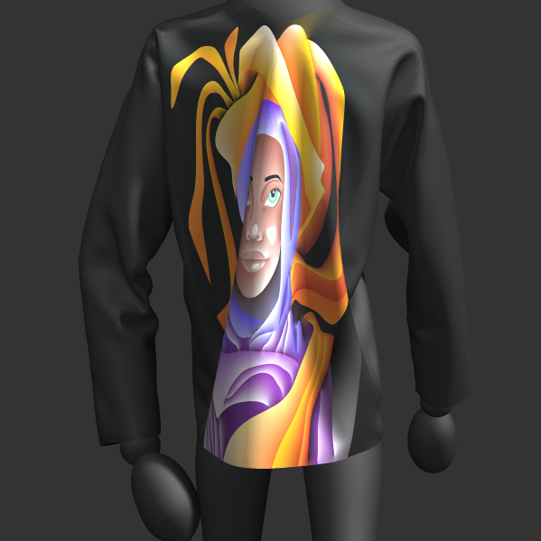
Our Goals
Efficient diffusion texture mapping
  Compact storage
  Random access
  Sharp boundary (resolution independence)
Notes:
To address these problems, we propose a diffusion curve texture representation for efficient texture mapping,
which supports random access, while keeping its compactness and resolution independence.

Slide 6
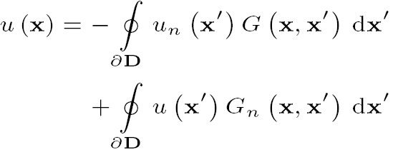

Key Idea
Implicit
$$u(x)$$
DCI
Texture value
Explicit
$$u(x)$$
DCI
Texture value
Notes:
Different from all previous methods that are based on an implicit representation defined by the Possion equation,
[click]
our key idea is to use an explicit representation of diffusion curve textures to avoid numerical solving of the Poisson equation on grids.
Specifically, we represent the diffusion curve images by Green’s kernels defined along the control curves.
[click]
With these kernels, the texture value at any point can be solved directly from the control curves, while preserving the compactness and resolution independence of diffusion curves.

Slide 7
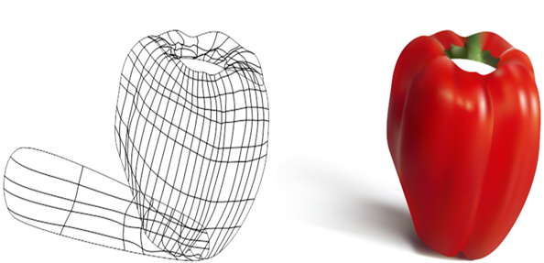
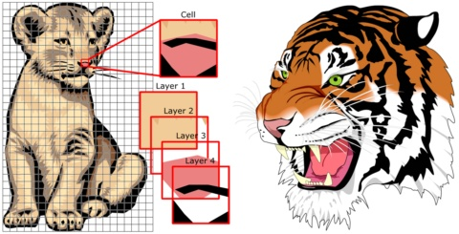
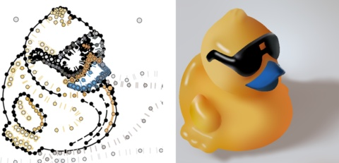
Related Work: Vector Representations
Gradient mesh
  [Lecot and Levy 06; Sun et al. 07; Lai et al. 09]
Lattice structure
  [Nehab and Hoppe 08]
Controlled Thin Plate Splines
  [Finch et al. 11]
Notes:
Our method is related to several previous works.
A number of vector representations have been proposed for images.
But it has always been challenging to map textures with rich and smooth shading variations.

Slide 8

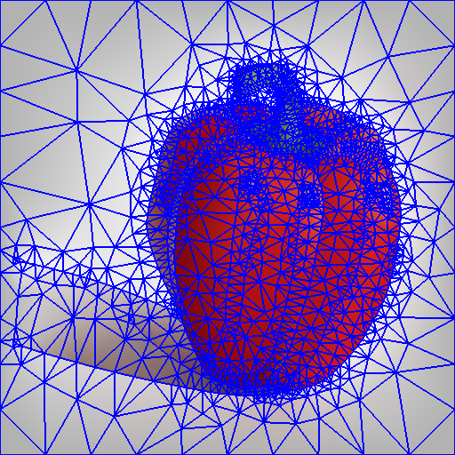
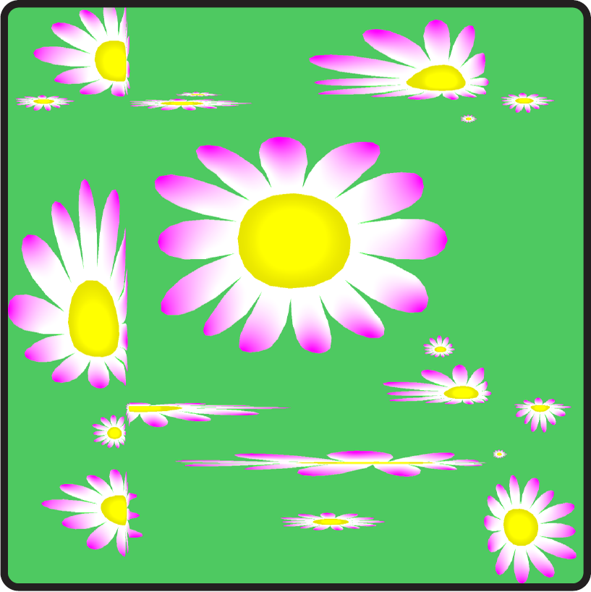
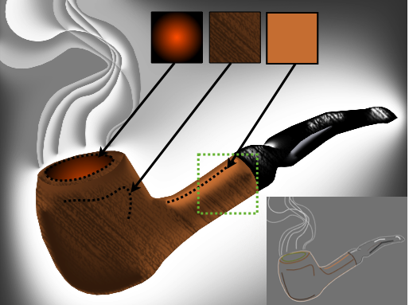
Related Work: DCI Reconstruction
Implicit solutions
  Regular grid
    [Orzan et al. 08; Jeschke et al. 09a]
  Triangle mesh
    [Pang et al. 11]
  Texture warping
    [Jeschke et al. 09b]
  Ray tracing [Bowers et al. 11]
  Independent evaluation (random access)
  Approximated DCIs
Notes:
For diffusion curves specifically, different methods were proposed for efficient DCI reconstruction,
but most of them are based on solving the Poisson equation because of the implicit representation.
[click]
Bowers et al. designed a ray tracing based approach for independent evaluation of DCI values.
But this approach gives only an approximation to the DCI instead of an accurate solution.

Slide 9
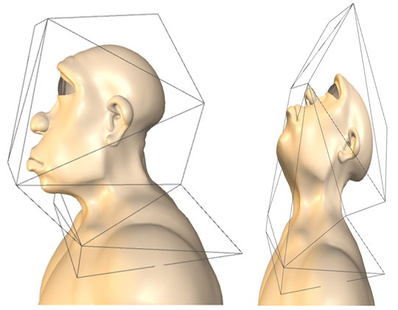
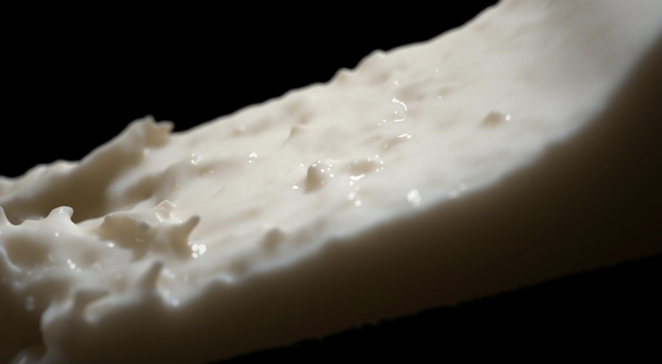
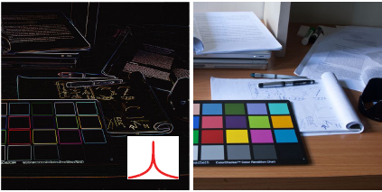
Related Work: Green’s Function
Green coordinates
  [Lipman et al. 08]
Quantized Green’s function
  [D’Eon and Irving 11]
Convolution pyramids
  [Farbman et al. 11]
Notes:
Green’s functions have been also applied in various graphics applications, including geometry processing, translucency rendering and image editing.

Slide 10
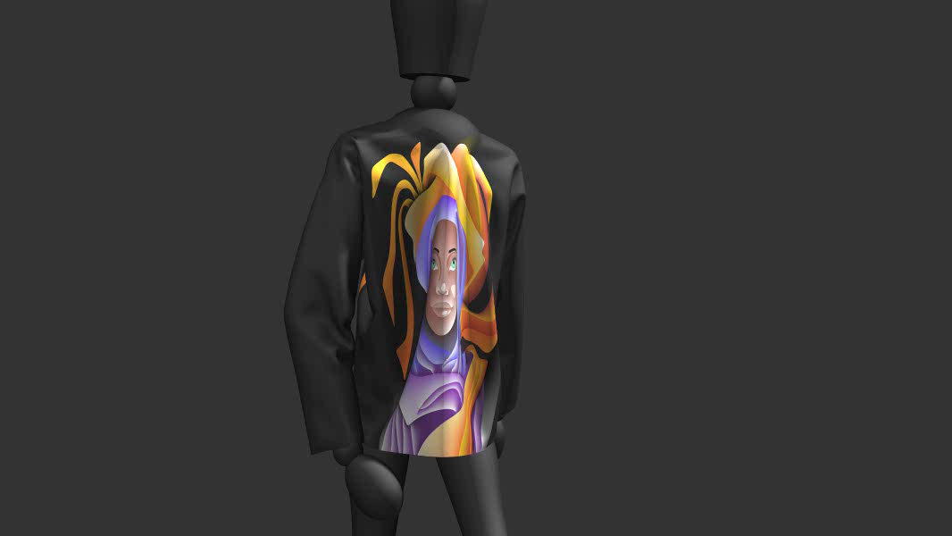
Zephyr
Notes:
Before we go into the technical details, we first show an example of mapping a diffusion curve texture onto geometry with our method. Note that smooth variations and sharp boundaries can be obtained in real-time.

Slide 11
An Explicit Diffusion Curve Texture Representation
Green’s function based kernels along each control curve (compact)
  Directly compute value at any position from the control curves (random access & sharp boundary)
  Closed-form solution for integral over a rectangular region (anti-aliasing)
Notes:
In the following, Guofu will introduce the technical details of our method and show more experimental results.
Thanks Xin! As Xin just introduced, the key idea of our method is to represent diffusion curve images with weighted Green’s function based kernels along each of the control curves. With this Green’s function based representation, the image value at any position can be directly evaluated.
Meanwhile, the integration of Green’s function kernels has a closed-form solution over a rectangular region.

Slide 12

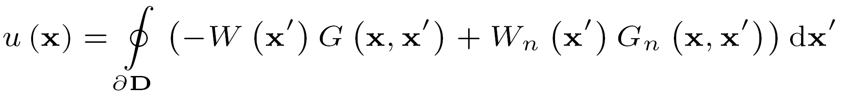

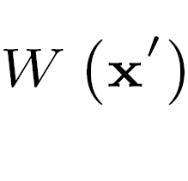
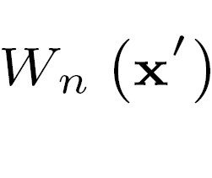












Green’s function
$$D$$
$$B$$
$$C_{l}(x^{′})$$
$$C_{r}(x^{′})$$
$$u(x)$$
$$D$$
$$B$$
$$W\left(x^{′}\right)$$
$$W_{n}(x^{′})$$
$$G\left(x,x^{′}\right)$$
$$G_{n}({x,x}^{′})$$
$$u(x)$$
Notes:
Given an diffusion curve image, defined by a control curve B, and the colors C_{l} , C_{r} specified on the two sides of each control curve
[click]
We can represent it with our explicit representation derived from Green’s second identity.
[click]
G is a Green’s function kernel, which is a log function in 2D.
[click]
G_{n} is the second kernel, defined by the derivative of Green’s function along the normal direction.
[click]
W and Wn are the weights of the Green’s function kernels.
[click]
Here, W and Wn can be directly computed through C_{l} and C_{r}.

Slide 13
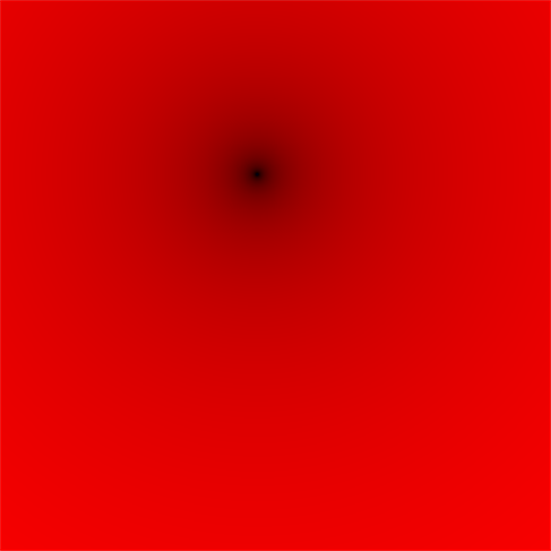


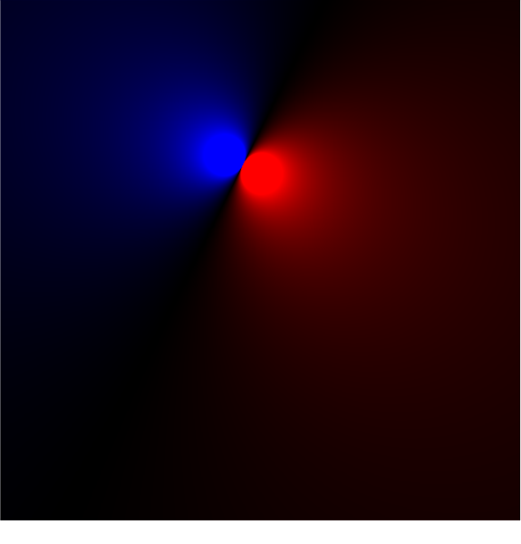
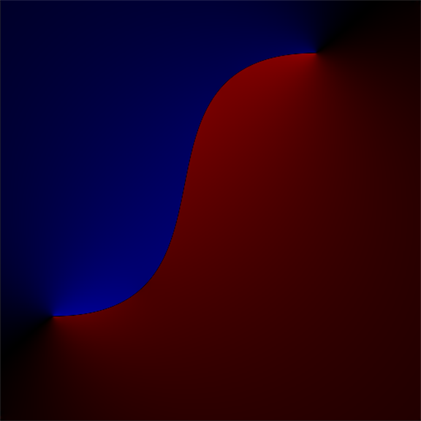













Explicit Evaluation – Random Access
$$W\left(x^{′}\right)$$
$$G\left(x,x^{′}\right)$$
$$G\left(x,x^{′}\right)$$
$$D$$
$$B$$
$$u(x)$$
$$u(x)$$
$$W\left(x^{′}\right)$$
$$W_{n}(x^{′})$$
$$G\left(x,x^{′}\right)$$
$$G_{n}({x,x}^{′})$$
$$u(x)$$
$$u(x)$$
$$W_{n}(x^{′})$$
$$G_{n}({x,x}^{′})$$
$$G_{n}({x,x}^{′})$$
$$u(x)$$
$$u(x)$$
Notes:
Based on this explicit representation, we can directly solve for the texture value at any position from the control curves.
For example, given a point x in the image,
[click]
Its value is determined by the two Green’s function based kernels G and Gn.
[click]
First, we compute a weighted contribution to x of these two kernels defined at each point along the control curve.
[click]
Here we visualize the profiles of these two kernels, with red indicating positive values, while blue indicates negative values.
[click]
Then, we integrate the contributions along the control curve.
[click]
To get the final result.
In this way, we can evaluate the texture value at any position independently.

Slide 14















Integration over a Rectangle – Anti-aliasing
$$W\left(x^{′}\right)$$
$$F_{G}\left(x,x^{′}\right)$$
$$G\left(x,x^{′}\right)$$
$$F_{G}\left(x,x^{′}\right)$$
$$G\left(x,x^{′}\right)$$
$$u(x)$$
$$u(x)$$
$$D$$
$$B$$
$$u(R)$$
$$u(R)$$
$$W\left(x^{′}\right)$$
$$W_{n}(x^{′})$$
$$F_{G}\left(x,x^{′}\right)$$
$$G\left(x,x^{′}\right)$$
$$G_{n}({x,x}^{′})$$
$$F_{G_{n}}({x,x}^{′})$$
$$u(R)$$
$$u(x)$$
$$u(x)$$
$$u(R)$$
$$W_{n}(x^{′})$$
$$F_{G_{n}}({x,x}^{′})$$
$$G_{n}({x,x}^{′})$$
$$G_{n}({x,x}^{′})$$
$$F_{G_{n}}({x,x}^{′})$$
$$u(x)$$
$$u(R)$$
$$u(x)$$
$$u(R)$$
Notes:
For anti-aliased rendering, the integral of texture values over a rectangular region needs to be computed instead of an individual point.
[click]
To accomplish this, we compute the contribution of these two kernels to a rectangle by integrating Fg and Fgn,
[click]
and then again integrate the contributions along the control curves.

Slide 15
Integration over a Rectangle – Anti-aliasing
Closed-form solution for integral over a rectangular region
  Constant computation for different size and orientation of regions
  Same processing at arbitrary positions (boundary or other)
$$W\left(x^{′}\right)$$
$$F_{G}\left(x,x^{′}\right)$$
$$F_{G}\left(x,x^{′}\right)$$
$$D$$
$$B$$
$$u(R)$$
$$W\left(x^{′}\right)$$
$$W_{n}(x^{′})$$
$$F_{G}\left(x,x^{′}\right)$$
$$F_{G_{n}}({x,x}^{′})$$
$$u(R)$$
$$W_{n}(x^{′})$$
$$F_{G_{n}}({x,x}^{′})$$
$$F_{G_{n}}({x,x}^{′})$$
$$u(R)$$
Notes:
The key advantage of our new representation is that the integration of these two kernels over a rectangular region has a closed-form solution.
[click]
As a result, the computational cost is constant for different size and orientation of regions.
[click]
Meanwhile, regardless of whether a region includes a control curve or not, our method can use the same closed form solution to compute its value.

Slide 16
Texture Mapping
Mesh
DCI texture
Notes:
In summary, our method can efficiently map diffusion curve textures onto arbitrary surfaces. As shown here,
Given a geometry mesh and diffusion curve texture,
[click] To find the texture value of a pixel,
[click] We map the pixel to its texture area in texture space, and use a rectangular region to approximate this area.
[click] Then, we evaluate the texture value of this region by integrating along the control curves,
[click] and obtain the texture value of the pixel.
[click] For all pixels, we compute their texture values in the same way.
[click] The integral along the control curves is computed by using a sampling scheme, which will introduce a large number of samples if we use dense uniform sampling rate.
So even this solution provides a uniform way to render diffusion curve textures over a mesh, the computational cost goes up quickly as the length and number of control curves increases. Therefore, we use an adaptive sampling and curve culling scheme to further speed up the rendering.

Slide 17
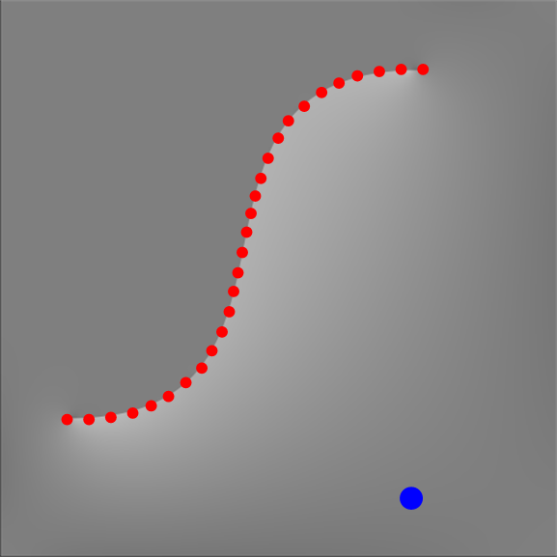
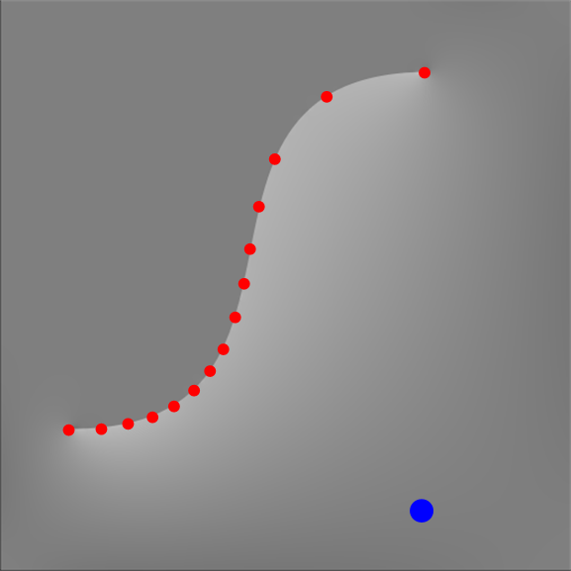
Texture Mapping Acceleration
Adaptive Sampling on Control Curves
Uniform sampling
Adaptive sampling
Notes:
Instead of uniformly sampling the control curves, we determine the sampling rate of curves based on the relative error of the evaluation.
This adaptive sampling scheme greatly reduces the sampling rate while maintaining rendering quality similar to that of dense uniform sampling.

Slide 18
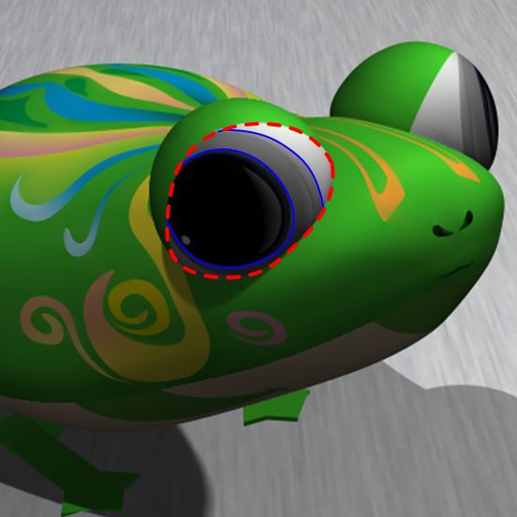
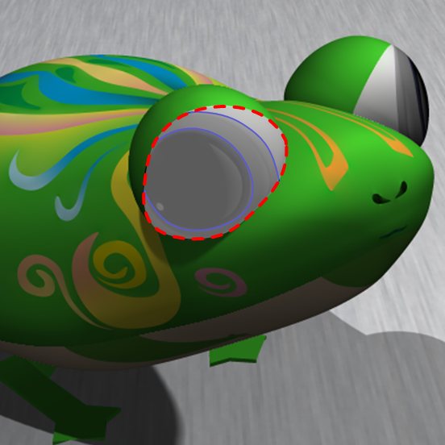
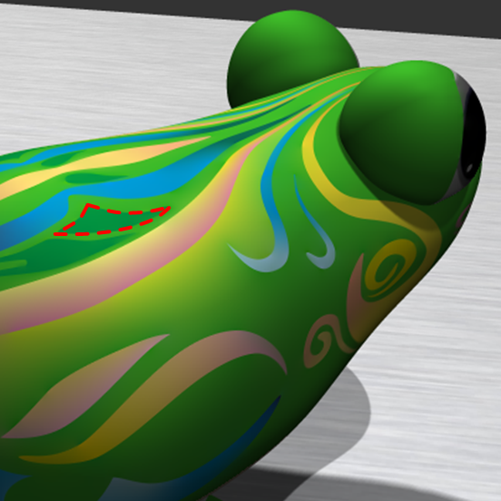
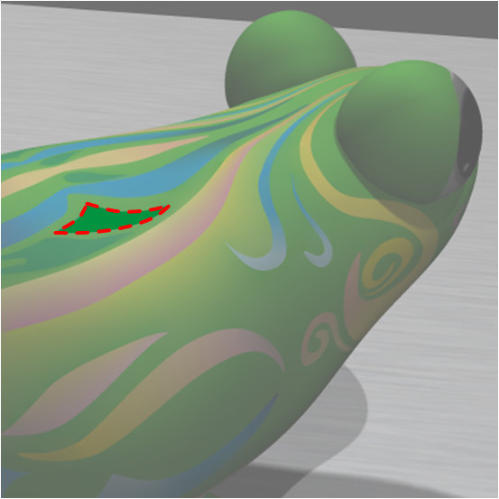
Texture Mapping Acceleration
Culling of Control Curves
Culling inner curves
Culling outer curves
Notes:
Moreover, control curves are culled when they cannot contribute to the texture values within a given region. As shown here,
[click]
In the left image, the blue control curves are enclosed by the red, so they do not contribute to image values beyond outer curves and can be culled.
[click]
In the right image, the region enclosed within the red control curve is unaffected by outer curves. So we can cull outer curves for this region.

Slide 19
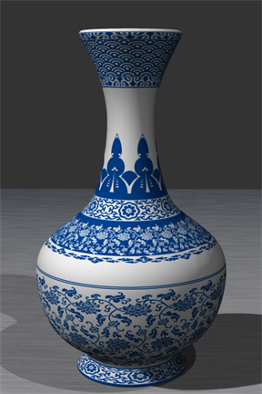
Performance for Acceleration Schemes
Uniform sampling
444.5s
Adaptive sampling
7.938s 50x
Adaptive sampling & culling
0.098s 5000x
Notes:
Here is a performance comparison of acceleration schemes.
The rendering cost of uniform sampling is expensive. The adaptive sampling scheme provides a 50 times speedup over uniform sampling, while the curve culling scheme further improves the rendering speed by two orders of magnitude.
Note that both acceleration schemes are based on the explicit representation proposed in our paper.

Slide 20
Implementation Details
Two Intel Xeon E5620 2.44GHz CPUs and an NVIDIA GeForce GTX 480
Number of curves: 160 ~ 37K
Storage: 13KBytes ~ 3MBytes
Performance: 10 ~ 30 fps
  Resolution: 800*600
Notes:
We implemented our algorithm on GPU.
The texture with up to 37 thousand curves only needs 3 Mega bytes storage.
It can still be rendered in real time with the resolution of 800 by 600.

Slide 21
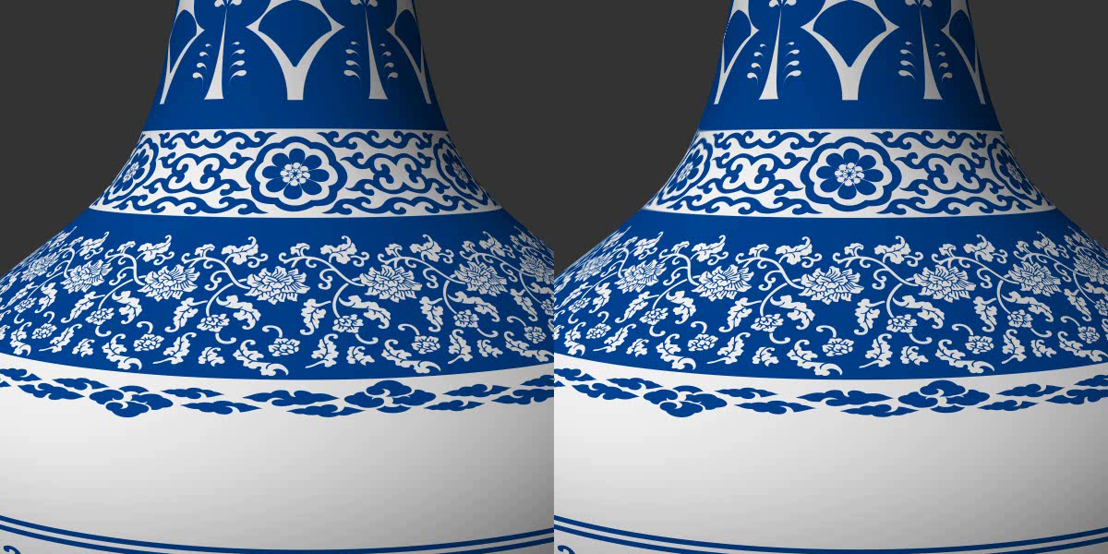
Sharp Boundaries in Close-up Views
8192² texture
Ours
Notes:
Here we show a comparison of sharp boundaries in close-up views.
[click]
Our method maintains the resolution independence of diffusion curve images and preserves the sharp boundaries of the texture pattern in close-up views.
By contrast, the results rendered from this high-resolution raster texture cannot maintain the sharp boundaries in the most close-up view.

Slide 22
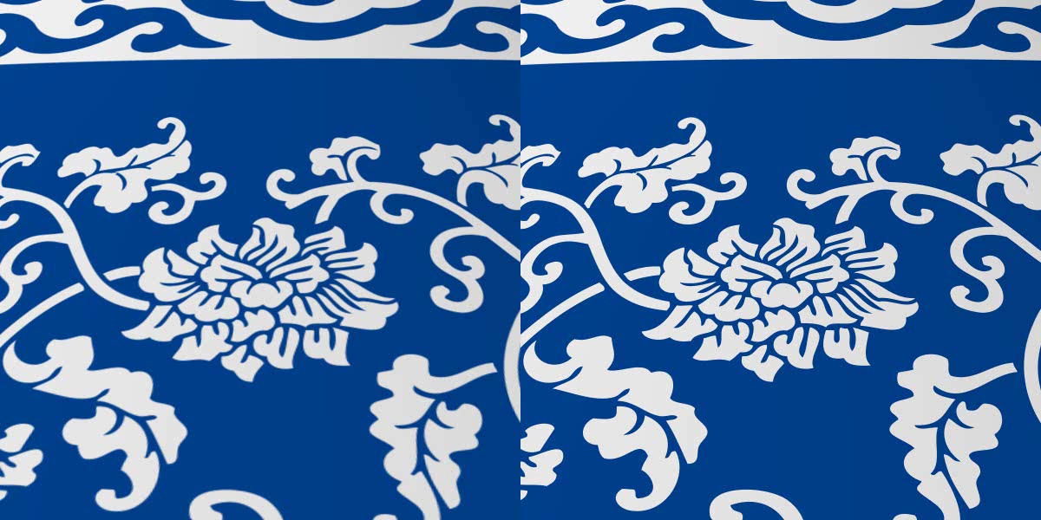
Anti-aliasing in Zoomed-out Views
8192² texture
Ours
Notes:
This video compares rendering results generated by our method and anti-aliased results under zoomed-out views. Here anti-aliased results are rendered from a mipmap raster texture.
[click]
Our method generates results similar to the conventional mipmap solution.
However, our method is based on a compact vector representation, and does not need to reconstruct a mipmap.

Slide 23
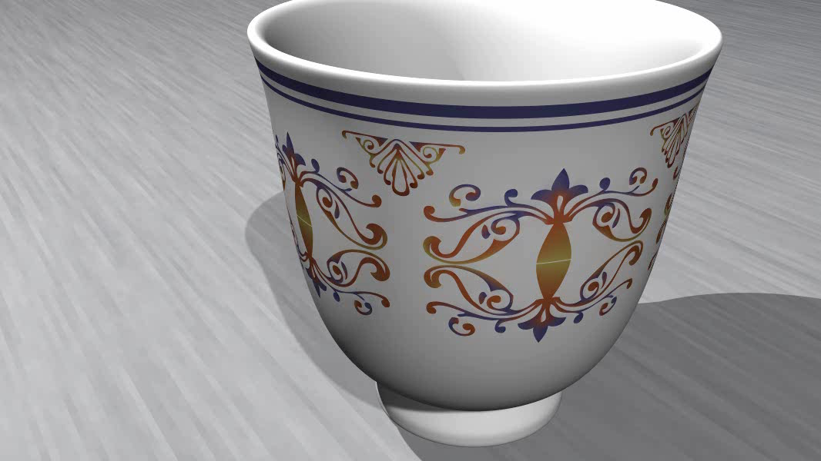
Results
Notes:
In this video, the color variations at different scales are effectively rendered by our method.
Note that the subtle shading details in the diffusion curve texture are well preserved.
For the parent model, our method conveys the natural color variations and sharp boundaries of the wood.
For the dragon model, the geometric shapes and texture patterns are both complicated, which makes it a challenge for existing diffusion curve rendering methods.

Slide 24
Contributions
Diffusion curve textures based on Green’s functions
Anti-aliased texture mapping of diffusion curve images
Exact reconstruction and real-time rendering performance
Notes:
In conclusion, we presented diffusion curve textures based on Green’s functions for anti-aliased texture mapping of diffusion curve images.
Our technique yields exact reconstructions of DCIs, and our GPU implementation provides real-time rendering performance.

Slide 25
Future Work
Acceleration for computing the weights of the Green’s function based kernels
Further acceleration of the rendering algorithm
Extend our framework to other differential operators
Diffusion surfaces in vector volume graphics
Notes:
Here we point out some possible directions for future work:
[click]
Our method needs a preprocess to convert a diffusion curve image to our representation for determining the weights.
We would like to speed up this preprocess to enable authoring and editing while rendering in real time.
[click]
Another is to further speed up the rendering algorithm to use our method for large scale rendering or desktop with limited computational resources.
[click]
A third direction is to extend our framework to other differential operators that may be used in vector image creation.
[click]
Diffusion surfaces are another interesting extension, as Green’s function kernels can be derived similarly for them.

Slide 26
Acknowledgements
Anonymous reviewers
  Valuable suggestions and comments
Yuan Tian and Shuitian Yan
  3D modeling and texture design
NSF of China (60833007)
  Partial support for Guofu Xie and Wencheng Wang
Notes:
We would like to thank many people for their valuable help in this paper.

Slide 27
Thank you!
Notes:
Thank you for your attention.

